Slide 1
Housing Stabilization Services
Minnesota Department of Human Services Housing and Support Services Division
Presenters: Bekah Kaufenberg-Satre, Mark Caldwell and Jensina Rosen
Notes:
Bekah starts.
Thank you for inviting the Minnesota Department of Human Services Housing and Support Services Division to be a presenter at the MCH Minnesota 2020 State Conference. My name is Bekah Kaufenberg-Satre, and my co-presenters are Mark Caldwell and Jensina Rosen. Today, we will be talking about Housing Stabilization Services, a new Medicaid benefit designed to help people with disabilities and older adults find and keep housing
If you are a provider or advocate supporting people to access Housing Stabilization Services, you can find more information via the links at the end of this presentation.

Slide 2
A new Medicaid benefit available as of July 20, 2020 to help people with disabilities and seniors find and keep housing.
Housing Stabilization Services
Notes:
Hopefully by now you all have heard about the new Medicaid Housing Stabilization Services benefit that launched on July 20, 2020. We are excited to be able to address the health of our Medicaid recipients by offering this service to stabilize people’s housing.
For today’s presentation, we will provide a high-level overview of the service. For more details on the services, please check out our policy webpage which has detailed policy information and a PowerPoint for a December 2019 that goes into more specifics about the services.

Slide 3
Goals of the Services
Support an individual's transition to housing
Increase long-term stability in housing
Avoid future periods of homelessness or institutionalization
Notes:
The goals of this service are: [read slide].

Slide 4
Housing Stabilization Services
Transition
Helps people plan for, find and move into housing
Sustaining
Supports a person to maintain living in their home
Housing Consultation: A new planning service available through Housing Stabilization Services that provides a person-centered plan for people without Medicaid funded case management
Notes:
Start :The two primary services in Housing Stabilization services are: [read transition and sustaining sections]
These services are not sequential. A person doesn’t need to have used transition services to access sustaining services. If a person first needs supports to maintain their current housing they can access sustaining services right away.
There is also a third component, Housing Consultation. [Read slide]
.

Slide 5
What are transition/sustaining services?
Transition Services
150 hours per transition
Housing search and application process
Budgeting
Organizing move and locating funding for deposits or household needs
Identifying benefits to help promote housing stability
Sustaining Services
150 hours per year
Develop and update a crisis or safety plan
Educate on tenant-landlord rights and responsibilities
Advocacy to prevent eviction
Training on being a good tenant, lease compliance, and household management
Notes:
Let’s dig into housing transition and sustaining services a bit more.
Some examples of transition services include: [read left block]
Some examples of sustaining services include: [read right block]
A person can receive services remotely, and if additional barriers are in place, a person can receive an additional 150 hours per transition or 150 hours of sustaining services each year to help support a person’s housing search or housing stability. Some examples of barriers include prior evictions, past due bills, or the presence of a criminal history.

Slide 6
Eligibility for Housing Stabilization Services
Medical Assistance recipient who is 18 years old or older
Disability or disabling condition
Housing instability
Need for services due to limitations caused by the individual's disability
Notes:
To be eligible for the service, an individual needs to be a Medical Assistance recipient and age 18 or older. Beyond this, there are three basic eligibility criteria: [read slide]. We’ll go into more detail in the next few slides.

Slide 7
Disability/Disabling Condition
Aged, blind, or disabled as described under Title II of the Social Security Act (SSI/SSDI)
People determined by a medical professional to have any the following conditions:
Long-term injury or illness
Mental illness
Developmental disability
Learning disability
Substance use disorder
Proof of disability:
Professional Statement of Need
Medical Opinion Form
Proof of receipt of SSI or SSDI
Other forms of disability documentation to be determined
Notes:
Housing Stabilization Services uses the expanded definition of disabling condition as established by Department of Human Services Housing Support guidelines. A person does not need to be certified disabled in order to access these services.
Read slide
Note that in June 2020, the Department of Human Services released an updated Professional Statement of Need. The Professional Statement of Need now includes eligibility criteria for Housing Stabilization Services.
County designees cannot complete the PSN for Housing Stabilization purposes.

Slide 8
Housing Instability
Meets Minnesota’s definition for homeless
At-risk of homelessness
Currently transitioning or have recently transitioned from an institution or licensed or registered setting
Eligible for waiver services
Housing instability can be documented by:
Professional Statement of Need
MnCHOICES Assessment or Long-Term Care Consultation (LTCC) (for persons with a need for Long Term Services and Supports)
Coordinated Entry Assessment (for persons experiencing homelessness)
Notes:
An individual or family is considered homeless when they lack a fixed, adequate nighttime residence. At-risk of homelessness occurs when (a) the individual or family is faced with a situation or set of circumstances likely to cause the household to become homeless, including but not limited to: doubled-up living arrangements where the individual’s name is not on a lease, living in a condemned building without a place to move, having arrears in rent/utility payments, receiving an eviction notice without a place to move and/or living in temporary or transitional housing that carries time limits; or (b) the person, previously homeless, will be discharged from a correctional, medical, mental health or substance use disorder treatment center, and lacks sufficient resources to pay for housing, and does not have a permanent place to live.
Includes Housing With Services, Board and Lodge, Boarding Care, Adult Foster Care, hospital, ICF-DD, Intensive Residential Treatment facility, Minnesota Security Hospital, nursing facility, Regional Treatment Center

Slide 9
Assessed Need for Services
Requires assistance due to their disability in one of the following areas:
Communication
Mobility
Decision-making
Managing challenging behaviors
Assessed need for services can be documented by:
Professional Statement of Need
MnCHOICES Assessment or Long-Term Care Consultation (LTCC) (for persons with a need for Long Term Services and Supports)
Coordinated Entry Assessment (for persons experiencing homelessness)
Same as housing instability
Notes:
In addition to having a disabling condition and housing instability, a person must be assessed to need assistance due to their disability in one of the following areas [Read slide].
Assessed need will be captured in each of the three assessment pathways. It is important to note that the Professional Statement of Need is the primary pathway onto the services because it captures all three needs-based criteria (disability, housing instability, and assessed need for services).
I will now turn it over to Mark who will talk about coordinated entry and person-centered planning.

Slide 10
Coordinated Entry Questions in HMIS
There are 5 questions that have been developed by DHS that aligns with the other pathways onto this service: MnChoices and Professional Statement of Need
These questions are located in Homeless Management Information System (HMIS) as part of the Coordinated Entry (CE) Assessment for each Continuum of Care (CoC)
CoCs will determine where the questions will be in the CE assessment
All people who receive a CE assessment must have responses to these questions to ensure access to this service
These questions ask about housing instability and assessed need as part of eligibility requirements for these services

Slide 11
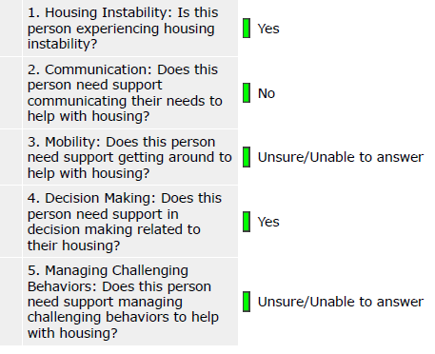
Coordinated Entry Questions in HMIS
Based on their experience with the person, Coordinated Entry assessors review the following 5 questions and use their professional judgement when selecting responses.
Responses to these questions are used to generate the CE assessment document that a person will need for these services.

Slide 12
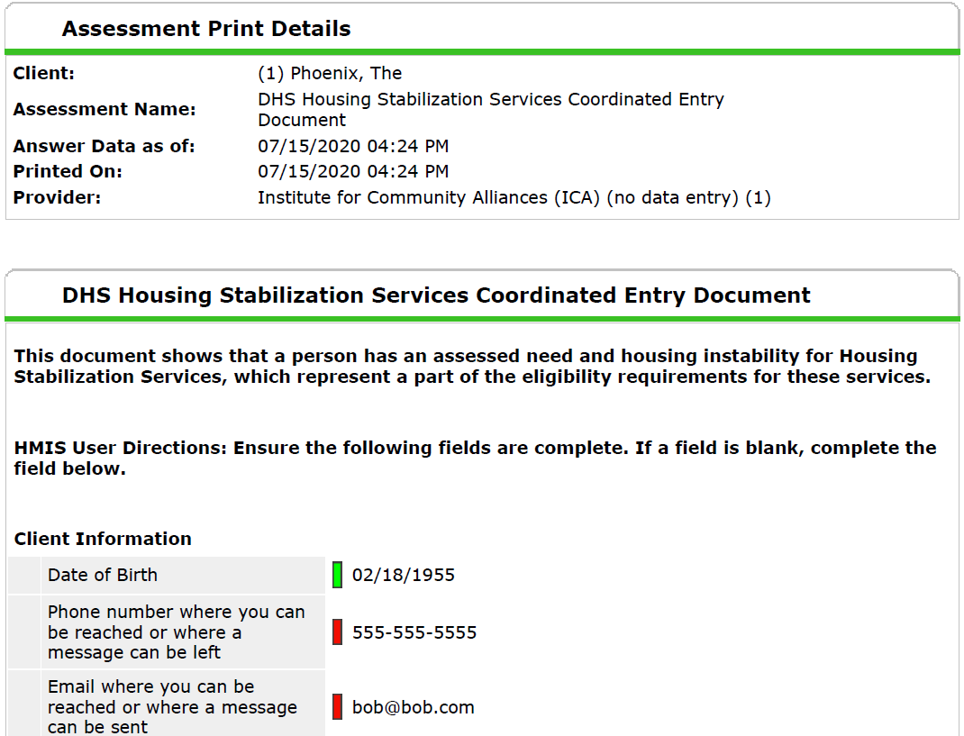
Coordinated Entry Assessment Document

Slide 13
Coordinated Entry Assessment Document
This document can be printed for the person. It will also be saved as a PDF that can be sent to an email address or stored in their “Vault” on HB101.org.
In addition to this document, a person will still need proof of disability and a person-centered plan to meet the all of the eligibility criteria.
Assessors and other CE staff can direct people to get in touch with their targeted or waiver case manager to complete their plan.
If someone doesn’t have a targeted or waiver case manager, you can direct them to an enrolled Housing Consultant who can complete their plan.
Organizations involved in the CE process may want to enroll as providers to help get people onto services and add a new revenue stream to pay for staff.

Slide 14
Home and Community Based Service: Person-Centered Plan Requirements
Everyone receiving Housing Stabilization Services will be required to have a person-centered service plan. The person-centered planning process must:
Be driven by the individual,
Include the person’s strengths, interests, wants as well as what supports they need, and
Help the person make an informed choice about their housing stabilization service provider.
Notes:
Start: Housing Stabilization services are Home and Community based services and must meet all CMS home and community based requirements. One of these requirements is that a person must have a person centered plan. [Read slide. ]

Slide 15
Who Does the Person-Centered Plan?
Current roles required to complete plan:
Waiver case manager-Coordinated Services and Support Plan
Targeted case manager (Adult Mental Health, Child Mental Health, Vulnerable Adult/Developmental Disability, Child Welfare)- Housing Focused Person Centered plan
Senior care coordinator – Coordinated Care Plan
New service for people who do not have a Medicaid case manager or senior care coordinator:
Enrolled Housing Consultation provider- Housing Focused Person-Centered Plan
Notes:
The responsibility of the person-centered plan depends on if other professionals are involved in the person’s life.
If a person already has a MA-funded waiver case manager, that person will complete or update the Coordinated Services and Supports Plan or the Coordinated Care Plan to include housing stabilization. If a person has a targeted case manager, the targeted case manager completes a Housing Focused Person-Centered Plan. If a person does not have a TCM or MA-funded case manager, then the person needs to find an enrolled housing consultant in the area to complete this requirement. We recently published the Housing Focused Person-Centered Plan, and it is available for review through the Department of Human Services eDOC page.

Slide 16
Accessing Services
Assessment:
1.PSN
2. MnChoices/ Long Term Care Consultation (LTCC)
3. Coordinated Entry Assessment
Housing Stabilization Services Provider Submits:
1. Assessment
2. Plan
3. Documentation of disability/disabling condition
Eligibility Review:
1. Provider notified through MN-ITS that they can begin working with person.
Plan:
1. Housing Focused Person Centered Plan (Housing Consultant/Targeted Case Manager)
2. Community Services and Supports Plan (Waiver Case Manager)
3. Coordinated Care Plan (Senior Care Coordinator)
Eligible Person
Notes:
In summary, this is a visual of the process an eligible person takes to enroll in Housing Stabilization Services, from assessment to eligibility review, which is what we will cover in the next session. [Read slide completely]
I will now turn it over to Jensina who will conclude the presentation.

Slide 17
Housing Stabilization Services and Other Services
Housing Stabilization Services duplicates:
Housing Access Coordination in 1915(c) waivers—these will be removed from waivers, and you will access through state plan. You will transition onto Housing Stabilization Services at their annual renewal with their waiver case manager.
You cannot receive Housing Stabilization Services and the following services at the same time:
Relocation Service Coordination
Assertive Community Treatment (ACT)
Moving Home Minnesota (MHM)
Notes:
There are some services you can’t get at the same time as you receive Housing Stabilization Services. These services include [read slide]
ACT – if you are on an ACT, you cannot have HSS however, you are supposed to receive housing support services while on ACT. If you have questions about housing and you are on an ACT Team, reach out to your case manager for help.

Slide 18
Housing Stabilization Services and Other Services
Housing Stabilization Services will NOT duplicate these services. If more intensive housing-related services are needed, you can receive these services and the new benefit:
ARMHS
Targeted Case Management (TCM) (not housing consultation)
1915(c) waiver services (not Housing consultation)
Semi Independent Living Services (SILS)
Behavioral Health Homes (BHH)
Healthcare care coordination (e.g., through Substance Use Disorder reform services or CCBHC)
Notes:
[Read Slide]
So, you can have a ARMHS worker and a Housing Stabilization Services provider. Or, you could have a TCM and a Housing Stabilization services provider.

Slide 19
Home and Community-Based Services: Conflict of interest requirement
Assessment
Health professional (physician, NP, social worker, etc.) OR
LTCC certified assessor OR
Trained CES assessor
Housing-focused plan
Case manager OR
Enrolled Housing Consultation provider
Housing Transition and Sustaining Services
Enrolled Housing Stabilization Services provider
May be same provider
Notes:
One of the requirements of Home and Community-based Services is that assessment and planning must be independent and free of conflict from service provision. However, it is an important federal requirement for these services. Note that providers can always be enrolled to provide both housing consultation and housing transition/sustaining services. Providers just cannot provide them to the same person if an exception is not in place….

Slide 20
Home and Community-Based Services: Conflict of Interest Requirement EXCEPTIONS
A conflict of interest exception is required for a provider agency to do the assessment/plan and transition/sustaining service for the same person.
Conflict of interest exceptions are only for provider shortage by:
geographic area
cultural/language specific providers
Providers will submit an exception request to DHS to determine if they can waive the conflict of interest.
Notes:
There will be an exception process to the conflict of interest requirement. These exceptions are only for provider shortages in certain geographic areas or for providers that specialize in serving a particular cultural group or non-English speakers. There will be a process to submit an exception request if you think you meet one of these categories.
It is important to note that due to COVID, the conflict of interest requirement is waived through the duration of the public health emergency. However, providers should be prepared to come into compliance with this requirement as the waiver ends at the conclusion of the public health emergency. On 10/24/2020, HHS Secretary Azar renewed the federal Public Health Emergency with regard to COVID-19. Public Health Emergencies must be renewed every 90 days, so now the federal PH emergency is scheduled to end 1/24/2020.

Slide 21
Strategically Plan and Deliver Services
Consider ways to maximize Housing Stabilization Services and integrate it into your community!
Recruit counties and tribes to provide housing consultation services for people not receiving MA-funded case management
Creates more access to the services
Frees up community-based providers to offer housing transition/sustaining services
Consider ways Housing Stabilization Services can help fund parts of the coordinated entry system (i.e., housing transition services)
Think about how Housing Stabilization Services can cover services paid for through state grant dollars, and how to target those dollars toward services not covered by Medical Assistance

Slide 22
Additional Resources
DHS Websites
Housing Stabilization Services Policy Page
New! Important Program Announcements Section
Sign up for our mailing list to receive important announcements!
MHCP Provider Manual
MHCP Provider Directory
Search under Home and Community Based Services
Subtype “Housing Stabilization Services”
Frequently Asked Questions Document (PDF) – updated monthly!
Person-Served Workflow (DHS-7347)
Webinars
General Overview (recorded) on Housing Benefits 101 and Policy Page (PDF only)
Provider and County – Tribal Remote Regional Roadshows (slide decks and recorded presentations) on the HB101 Partners Page
Housing Benefits 101 (mn.hb101.org)
Helpful tools for people served, including benefits look-ups, budgeting pathways, and general information about Housing Stabilization Services (brochure/visual aids)
New Resources
Allowable Documentation for Housing Stabilization Services Eligibility Requests Guidance
Information for Targeted Case Managers Guidance and “Introduction to the Housing-Focused Person-Centered Plan” training on TrainLink
Contact Us!
dhshousingstabilization@state.mn.us
Notes:
Questions about new service

Slide 23
Additional Resources
Housing Benefits 101 (mn.hb101.org)
Helpful tools for people served, including benefits look-ups, budgeting pathways, and general information about Housing Stabilization Services (brochure/visual aids)
Vault feature, which allows for free, secure document storage and transmission
New! Pro Tools, including a Keeping My Housing Plan, to guide the work of housing sustaining providers
New! Person-Served Workflow (DHS-7347)
Reach out to Housing Stabilization Services Team anytime via e-mail at dhshousingstabilization@state.mn.us
Notes:
Transition and sustaining plans are required for these services. HB101 already has a wide variety of transition-related tools that can be used to build a transition plan. Soon to be uploaded will be a Keeping my Housing Plan, which, while not required, will provide a sustaining service plan.

Slide 24
Thank you for your participation!
Visit our webpage Contact us at: dhshousingstabilization@state.mn.us
Sign up for our mailing list to stay updated about our program here.
Notes:
If you have questions, please contact us at dhshousingstabilization@state.mn.us.

